Slide 1



Background To Select Theme (2)
7/10
PSNV Training Course holding status
Difficult open Face to Face training
COVID19 situation
Employee can not review the lesson
Training time was fixed
Trainer do repeated task
Reduce half FY2018 - FY2021
Develop people before making products
Problem:
Difficult to arrange training course and develop employees
under Covid19 situation
Issue 2
Employee not fully knowledge and skills
How to training & support for New Normal
How to increase chance to study

Slide 2




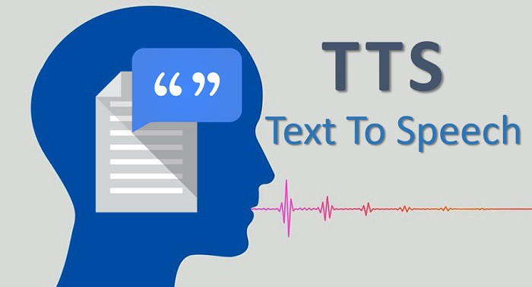




Improvement Activities (2)
8/10
Issue
2
Difficulty opening training course if long covid19
Employee not fully knowledge and skills
Lead to make a not good product and resignation increase
Current Situation
Solution
Covid19 training course opening ~50%
Not enough skill before start working
Easy make NG product & resignation
Opening online training course
Completed training & examination
Reduce NG ratio & job changing
Making E-learning system with AI technology


E-learning system making
Video making
Ex: 4h video making
New
Direct Training
Online Training
Video made by ②
8h
New
System
Recording
10min
Online Testing
Speech data
Paper Testing
Video
Editing
12h
Merge
PPT+ Speech
2h
Evaluation
Report
Manual Evaluation
Auto Evaluation
Total: 20h
Total: 2.2h
✵ We Can Reduce Covid19 Risky By E-learning System
Save: 29K$

